Slide 1
QUICK TEACH
Innovative service for teaching and learning
+ Nguyễn Đức Thành
+ Lê Quang Cường
+ Bùi Đức Tài
+ Nguyễn Minh Trí
+ Nguyễn Kim Thanh
+ Đào Quang Thịnh
+ Trần Phú Quang
Nhóm 2:

Slide 2

Nguyễn Đức Thành
Sở thích: Bóng đá
Contact : 097 4034407
Lê Quang Cường
Sở thích: Guitar
Contact: 01654181176

Slide 3

Bùi Đức Tài Sở Thích: Du lịch Contact: www.fb.com/Tai S
Nguyễn Minh Trí
Sở Thích: Tìm hiểu lịch sử VN Contact: www.fb.com/Minhtri

Slide 4

Nguyễn Kim Thanh
Sở thích: code Trần Phú Quang Đào Quang Thịnh Contact: Sở thích: Thiền tịnh tâm Sở thích: Ngắm mưa
0981815846

Slide 5
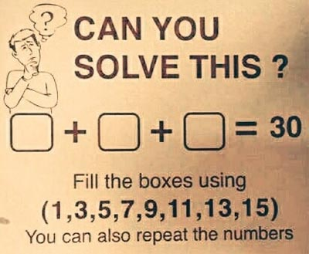
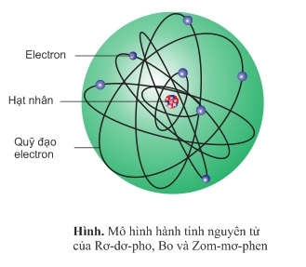
Problem
Cannot solve a problem ???
Do not understand a lesson ???

Slide 6
QUICK TEACH
Innovative service for teaching and learning

Slide 7



STEPS WE TAKE
We will go through these sections sequentially
Problem
Features
Difficulties
Q&A

Slide 8






Features
Solve a problem
Teach a lesson
Scope
Recruitment
Service fee
Conflicts

Slide 9
Features (cont)
Solve a problem & Teach lesson
Step 1
Step 2
Step 3
Step 4
Customers post problems on app, wait for the response from our staffs.
If a member from our staffs can slove that problem, he/she will contact to the customer to make deal.
There are two options: online & offline, online will make through Skype or Facebook..., offline – our staffs will go to customer’s house.
After finish the lesson, money will be pay directly on app depend on how long its take.

Slide 10
Features (cont)
Recruitment, Scope, Service fee and Conflicts
Recruitment
Scope
Service fee
Conflicts
1 – 12
<= 5km : 10k
5km – 10km: 15k
>= 10km: 35k
Primary school: 10k – 50k
Secondary school: 30k– 70k
High school: >= 70k
Recorder
Depending on review
- 50k
10% - 90%

Slide 11



Difficulties
Price
Low level tutors
Fake reviews

Slide 12


Slide 13
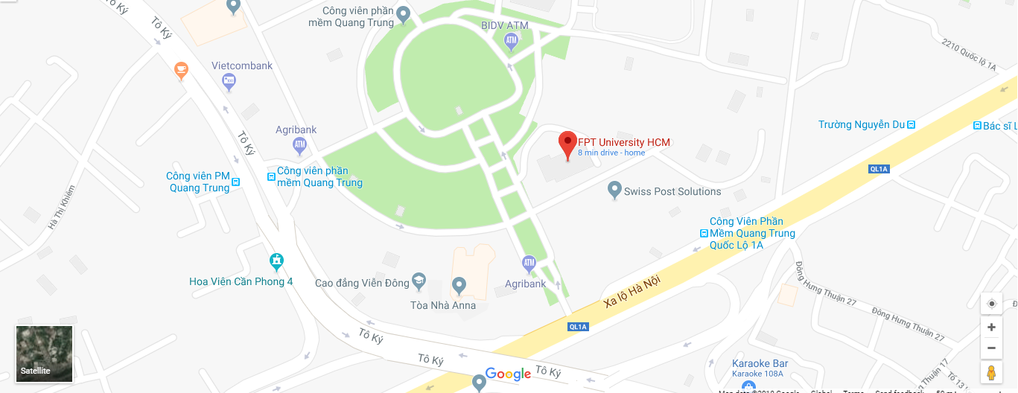
CONTACT US
This will be the Tagline for our slide
Contact us:
0905061508
www.quickteach.com
customer@quickteach.com

Slide 14
USED SOURCES
The websites & information we collected information from
Template powerpoint: https://www.udemy.com/case-study-powerpoint-2013-presentation-slide-by-slide/
Icon: https://www.flaticon.com/
https://okiaf.vn/
Music:
Lovely - Tryad

Slide 15

YOU HELD THROUGH !
Thank you!

